Slide 1
Proof-of-Concept

Slide 2
Methodology in solving this project problem statement
Main elements in the dataset are satisfaction_level, last_evaluation , number_project, average_montly_hours , time_spend_company, Work_accident, promotion_last_5years, dept, salary.
Comparison between certain elements in this can be used to solve.
Using Scatter plot in python we can scatter different points and using plot we can solve the problem.
Bar plot is used to count dept and salary (high, medium, low).

Slide 3
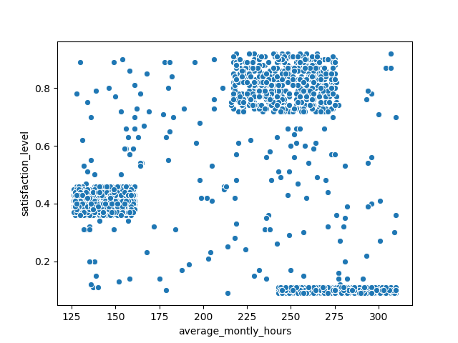
PLOT 1

Slide 4
PLOT average monthly hours vs satisfaction level
Many of ex- employees have low satisfaction level and they have working hours greater than 225.
Many ex_employees have an average satisfaction level of 0.4 and low working hours.
Many ex_employees have an average working hours above 200.

Slide 5
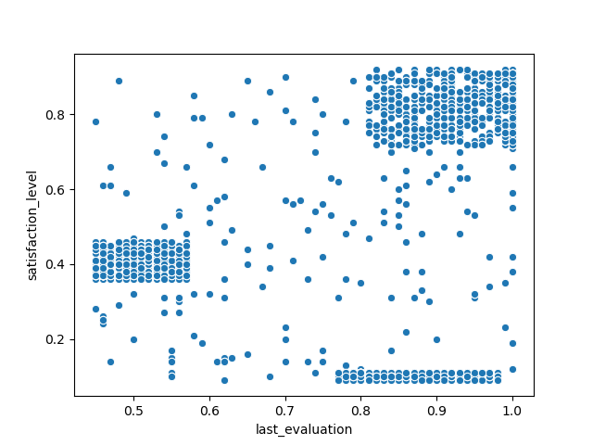
PLOT 2

Slide 6
Plot last evaluation vs satisfaction level
Many of ex- employees have low satisfaction level and have high last evaluation almost above 0.8
Many ex_employees have an average satisfaction level of 0.4 and low last evaluation.
Many ex_employees have high satisfaction level and high last evaluation.

Slide 7
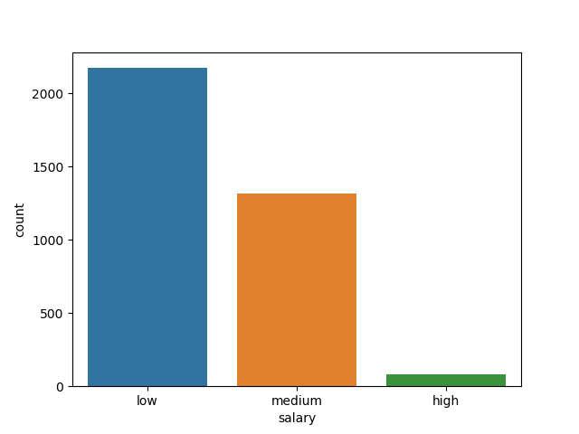
PLOT 3

Slide 8
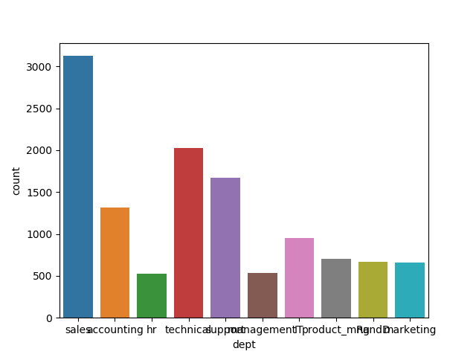
PLOT 4

Slide 9
Plot on salary and Plot on department
Many of ex- employees have salary low.
Many ex_employees have worked in sales department.

Slide 10
Which employees are prone to leave next?
Those employees with low satisfaction level may leave next.
Those employees with average monthly working hours greater than 200 may leave.
Those employees with high last evaluation may leave.
Those employees with low salary may leave.
Those employees working in sales department may leave.

